Slide 1

Presentation Planning
Davon Washington
Notes:
Welcome!
Today—Strategies to plan your presentation
Next—Create slides to illustrate these concepts

Slide 2

Know Your Audience
Notes:
This knowledge will guide many decisions.
Keep the presentation focused on your objectives.

Slide 3

Plan for Your Environment
Notes:
As much as possible, consider these environmental issues:
Lighting, windows
Cable/cord management for safety
Projection screen
Equipment arrangement
These factors will influence your slide show design.

Slide 4
Presentation Structure

Slide 5

Plan a Structure:
Opening
Body
Close
Be selective
You can’t include everything
Possible body sequences:
Topical
Chronological
Classification by categories
Problem and solution
Cause and effect
Notes:
Opening = Introduction
Body = 3 - 5 points
Close = Conclusion or summary
Also, prepare a slide at the end with your contact information.

Slide 6

Plan a Strong Opening
You’ll never have a second chance to make a first impression.
Notes:
In the first 30 seconds:
Grab attention and arouse curiosity
Get right to the point
Do not:
Be dull
Show little personality
Lack passion for your topic
Ramble
Answer one or more questions:
What is the problem or issue?
Who cares about it?
What is your solution or recommendation?

Slide 7

Plan for Audience Interaction
Build rapport
Get people involved in the discussion
How?
Notes:
Build a rapport with your audience
Plan ways to involve them in the discussion
Give practical examples so they can relate to them
Questions/answers during or after?
Decide in advance based on time constraints
It is best to hand questions before your close

Slide 8
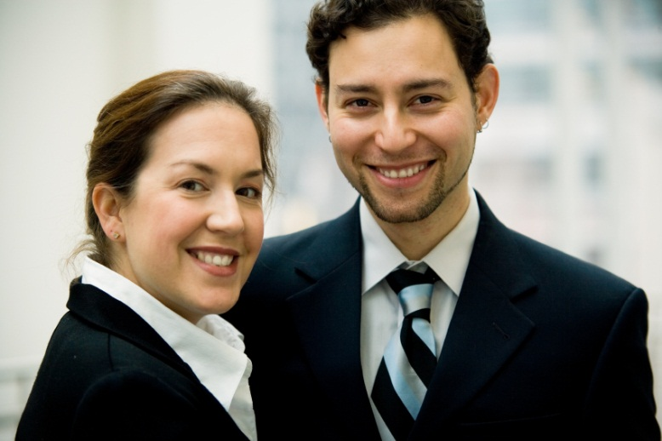
Consider Verbal/Visual Transitions
“Now John will discuss the new features of our benefit plan.”
Notes:
Plan transition between topics
Link
Introduce
Enumerate
Slides can be transition cues, too

Slide 9

Plan a STRONG Close!
Give your audience something to remember!
Notes:
Make it meaningful
“We have a long road ahead of us . . .”
Possibilities???
Summary statement
Restate key benefits
Motivating statement or quote
Action approaches???
Present a challenge
Review how to get started
Get commitment for action

Slide 10
Presentation Practice

Slide 11
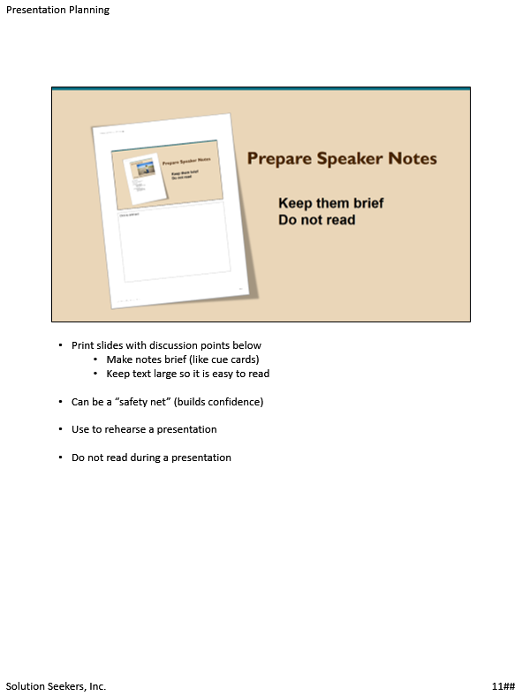
Prepare Speaker Notes
Keep them brief
Do not read
Notes:
Print slide with discussion points below
Make notes brief (like cue cards)
Keep text large so it is easy to read
Can be a “safety net” (builds confidence)
Use to rehearse a presentation
Do not read during a presentation

Slide 12

Determine Practice Goals
Notes:
Experience is the best teacher
Identify strengths and develop them
Identify weaknesses and work to overcome them
Reduce tendency to be nervous

Slide 13

Use Low-Tech Practice Methods
Watch yourself
Get help from others
Incorporate feedback
Practice again
Notes:
Practice presentation aloud and time yourself
Watch yourself in front of a mirror
First test flow of topics
Adjust sequencing or transitions as needed
Repeat presentation
Give the presentation to friends or colleagues
Incorporate their feedback
Practice again

Slide 14

Use PowerPoint to Practice
Use equipment
Record with narration
Make a video
Make adjustments
Notes:
Use equipment—on location if possible
Connect equipment pieces and decide best arrangement
Record your slide show with narration then play it back to study your voice and inflection
Make a video of your delivery then play it back and watch yourself
Watch first for an overall impression
Watch again without sound to study mannerisms
Listen to it without the picture to study vocal elements
Adjust your pace and vocal characteristics based on what you observe

Slide 15

Prepare a Backup Plan
What if your equipment fails?
Slide show copy
Handouts
Know what to do
Notes:
Have extra copies, external storage or online
Be prepared for equipment failure
Have handouts available—talk from those if necessary
Rehearse how to use your backup plan

Slide 16
Summary

Slide 17
Opening
Body
Close
Opening | Influences how an audience accepts your ideas
Body | The heart of the presentation
Close | Influences what an audience remembers
Notes:
The body is the heart of the presentation
Don’t underestimate the opening and the close:
Opening (Introduction)—influences how an audience accepts your ideas
Close (Conclusion)—influences what the audience remembers

Slide 18

Source: https://www.youtube.com/watch?v=Q5WT2vweFRY

Slide 19
Presentation Planning
Davon Washington
Solution Seekers, Inc.
200 North 4th Street
Nashville, TN 37200
615-768-3455
Notes:
Thank you for sharing with me today.

